Slide 1
Understanding Innovation in Screening and Diagnosis of Alzheimer’s Disease and Related Dementias
Network for Excellence in Health Innovation
April 11, 2024 | 1:00 – 2:30 PM ET

Slide 2
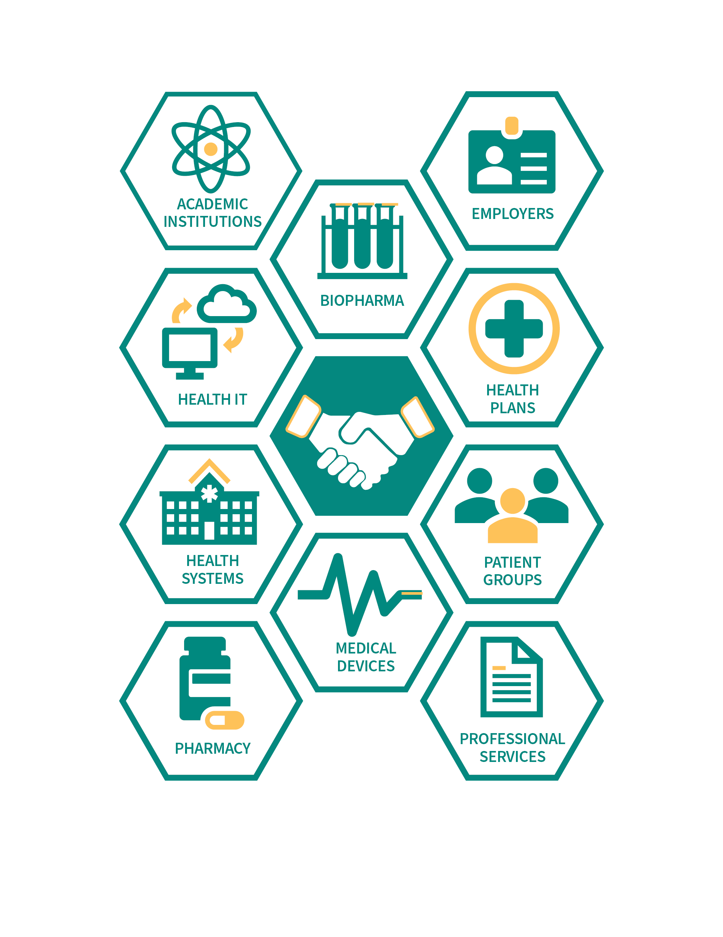
Who we are
NEHI is a national non-profit, non-partisan organization composed of stakeholders from across key sectors of health and health care
Through interdisciplinary collaboration and with our members’ guidance, we research and examine complex and timely health care innovation issues from multiple, often divergent, perspectives.
We then address policy and adoption challenges to promote the value of innovative products and processes.

Slide 3
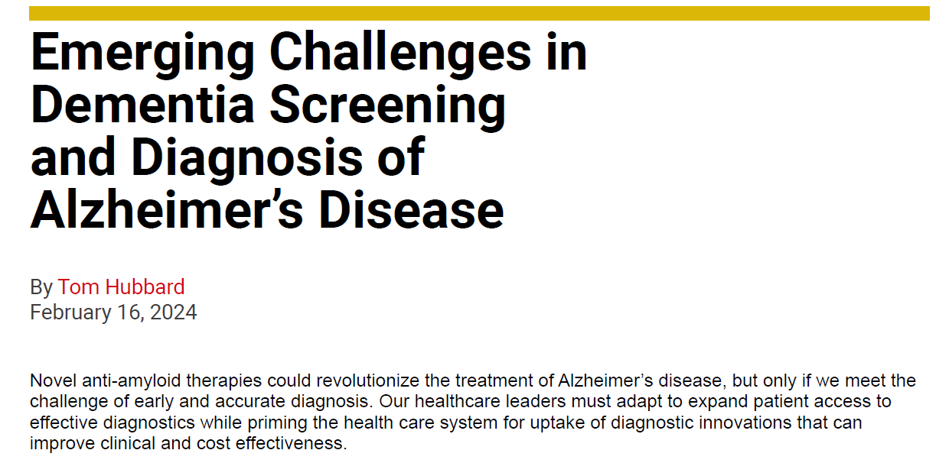

Slide 4
Key Points
A new era in Alzheimer’s disease care has begun
The health care system will now face the challenge of gaining capability for accurate and cost-effective testing for Alzheimer’s disease – at greater scale
The first step includes overcoming barriers to uptake of cerebrospinal fluid (CSF) analysis and PET imaging
Expanding the toolbox for screening and assessment of Mild Cognitive Impairment, dementia, Alzheimer’s, and other neurodegenerative conditions will be essential
The ideal goal is “right test, right time, right patient” – a paradigm shift in dementia screening and care

Slide 5
Innovations on parallel tracks
Markers of cognition, memory, behaviors
Examples:
Digitally-collected data on memory, gait, eye movement, activities of daily life
Biochemical biomarkers
Examples:
Improvements in the current “gold standard” approaches: PET imaging, CSF analysis
Genetic testing
Launch of minimally-intrusive and non-intrusive testing such as blood-based biomarker tests and tests of other fluid biomarkers
AI-enabled analysis of multiple, integrated data sources

Slide 6
Implications
Ongoing challenge of overcoming barriers to patient access to screening, assessment, CSF and PET imaging when appropriate
Stresses on primary care
“Neurology deserts” throughout the country
Significant racial/ethnic, urban/rural disparities
Medicare coverage of PET for amyloid detection now expanded but policy is set at the regional level
Integrating minimally or non-intrusive testing into primary care and other frontline sites of service
Over time: Determining reasonable guidelines, policy, and support for detection of “Stage 1” disease
Pre-symptomatic detection of Alzheimer’s and other neurodegenerative diseases

Slide 7
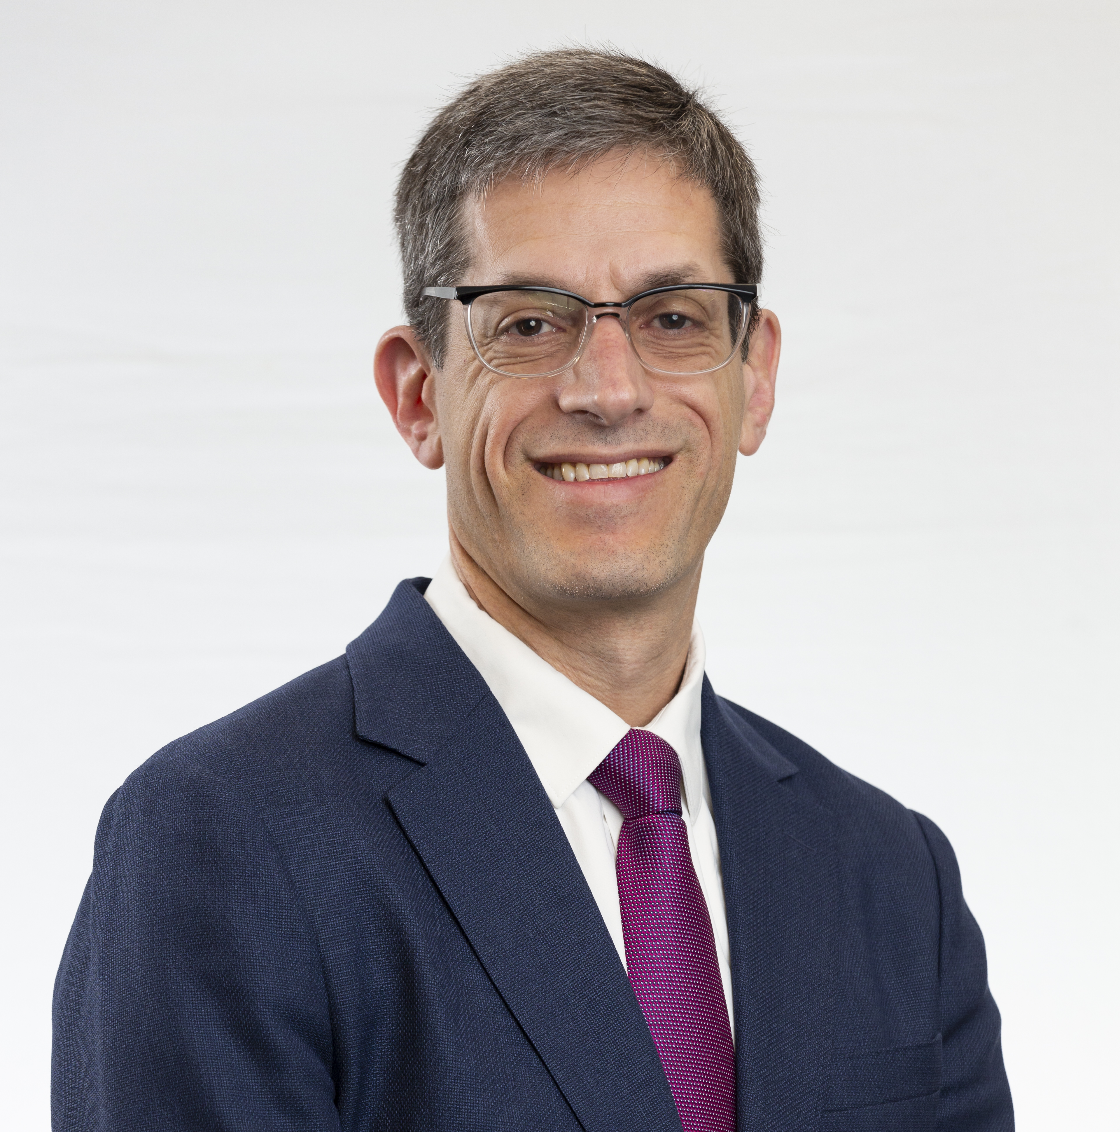
Thank you to our panelists for participating in our discussion today
Joel Braunstein, MD
CEO
C₂N Diagnostics
Ian Kremer, JD
Executive Director
Leaders Engaged on Alzheimer’s Disease (LEAD) Coalition
David Bates, PhD
CEO
Linus Health
7

Slide 8
Discussion kick-off
Is the approval (or pending approval) of new therapies creating a greater demand for screening and diagnosis of dementia around the country right now?

Slide 9
Upcoming public NEHI roundtable
When: Thursday, May 23, 1-5 PM ET
Where:
In person: Kaiser Permanente Center for Total Health in Washington D.C.
Virtually via MS Teams
Purpose: To discuss pragmatic actions that can be taken to encourage earlier dementia and MCI screening and assessment, including recommendations for change in policy and practice that will enable adoption of innovative tests and tools for screening, patient assessment, and diagnosis.
Registration link: https://www.nehi-us.org/events/the-alzheimers-disease-patient-journey-pathways-to-early-stage-screening-and-detection-a-nehi-led-roundtable

Slide 10
Thank you!
Tom Hubbard, thubbard@nehi-us.org
Lauren Bedel, lbedel@nehi-us.org

